Slide 1

ministorage
CT290DS003
Team Member:
Liu Chak Tin (22)
Tam Wood Sun (14)
Ko Kin Keung (16)
Siu Wan Cheuk (5)

Slide 2
Objective
To build website of a Mini Storage company, which provides information of:
Mission and services of the company
Branches in different region of Hong Kong
Details of each individual branches
Enable users to register and log in and view their orders
Enable users to book storage box online
Enable admin users to create, edit, update and delete user, warehouse and transaction information
Enable users to contact the company via different media platform

Slide 3
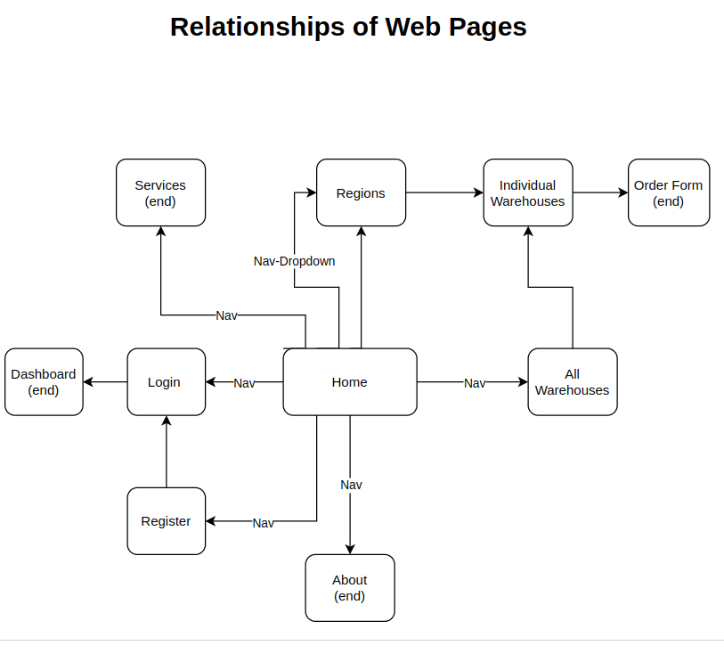
UML

Slide 4
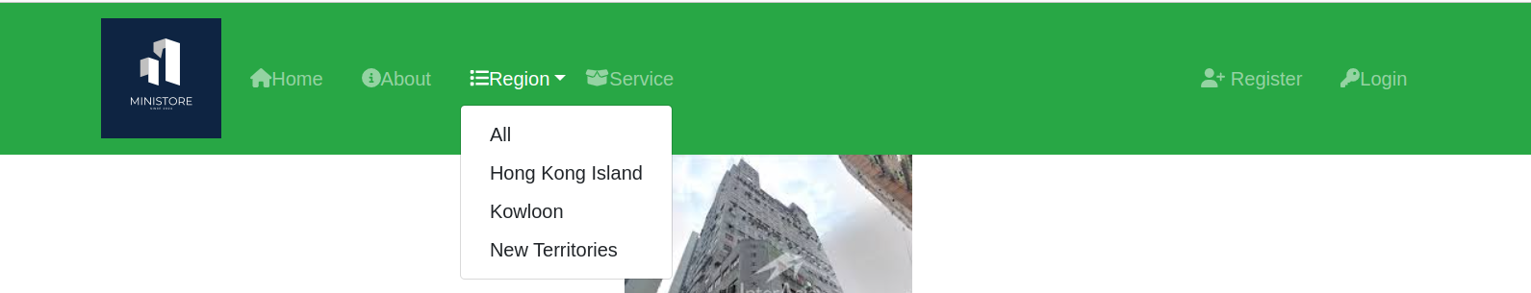
Nav Bar
Navigate to Home, About, Region, Service, Register and Login pages
Create Dropdown in Region to select around All, Hong Kong Island, Kowloon, New Territories

Slide 5

Footer
Click different buttons for media to leave contact in media platform from hyperlink
Back to top by clicking the button

Slide 6
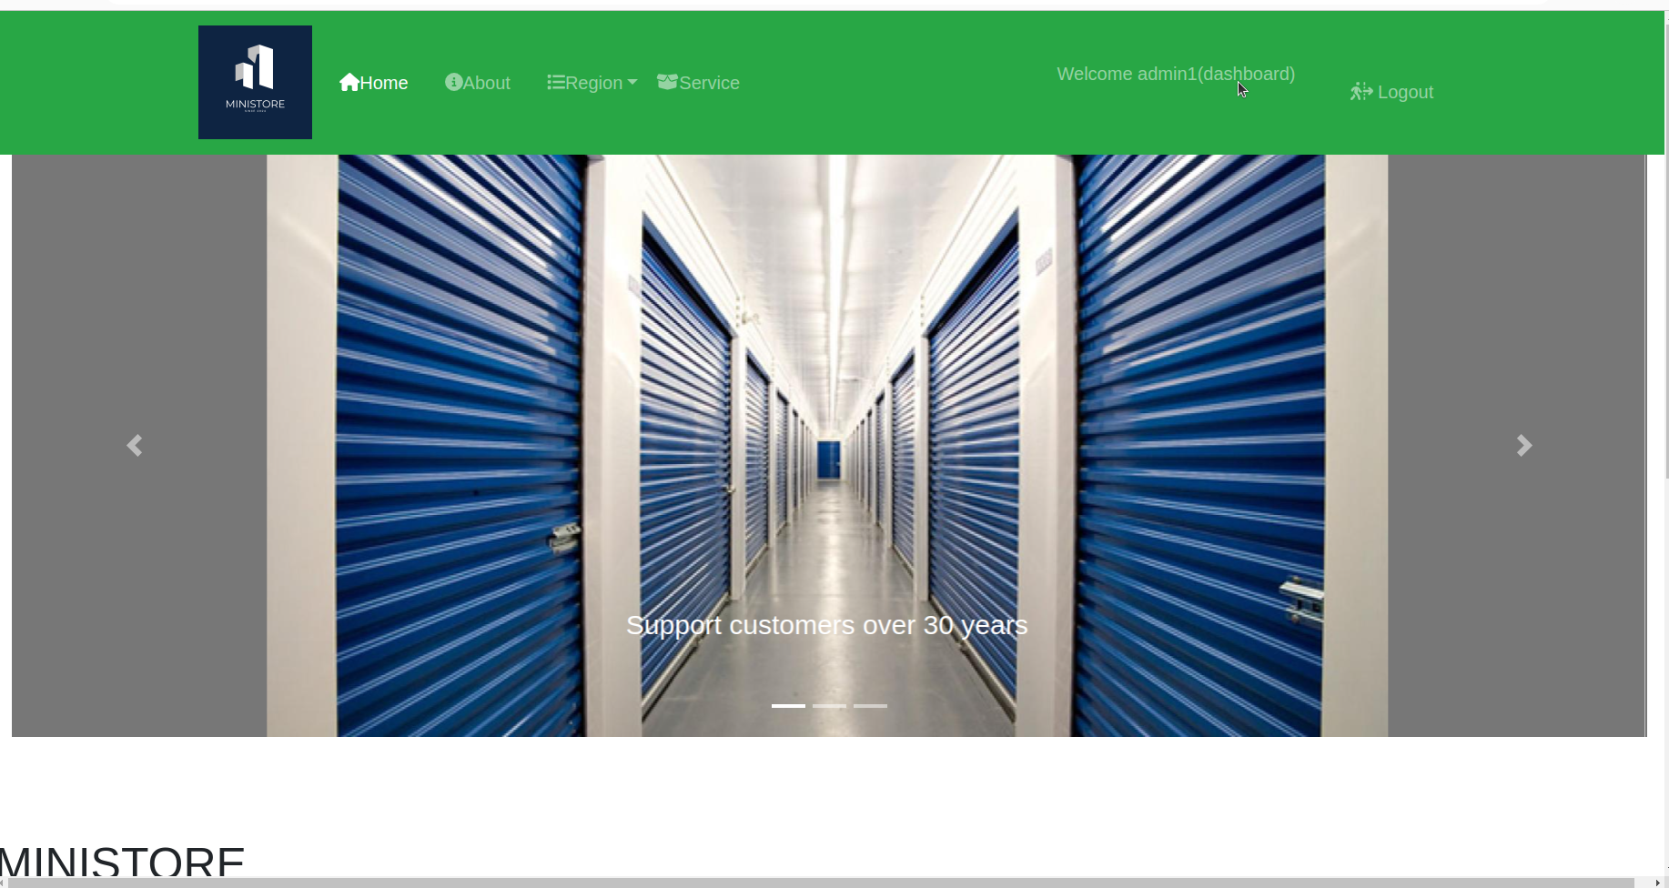
Home Page
Company information being shown by ‘Carousel’

Slide 7
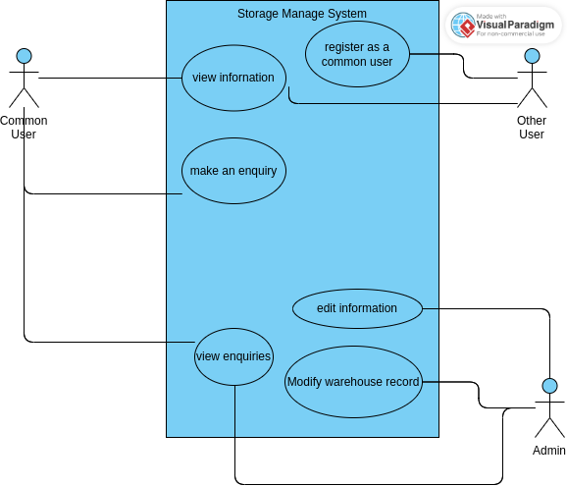
UML

Slide 8
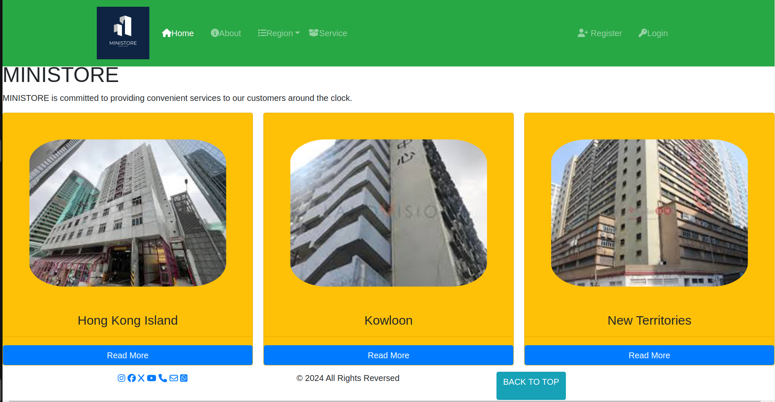
Home Page
Navigate to region pages by “Read More” button link

Slide 9
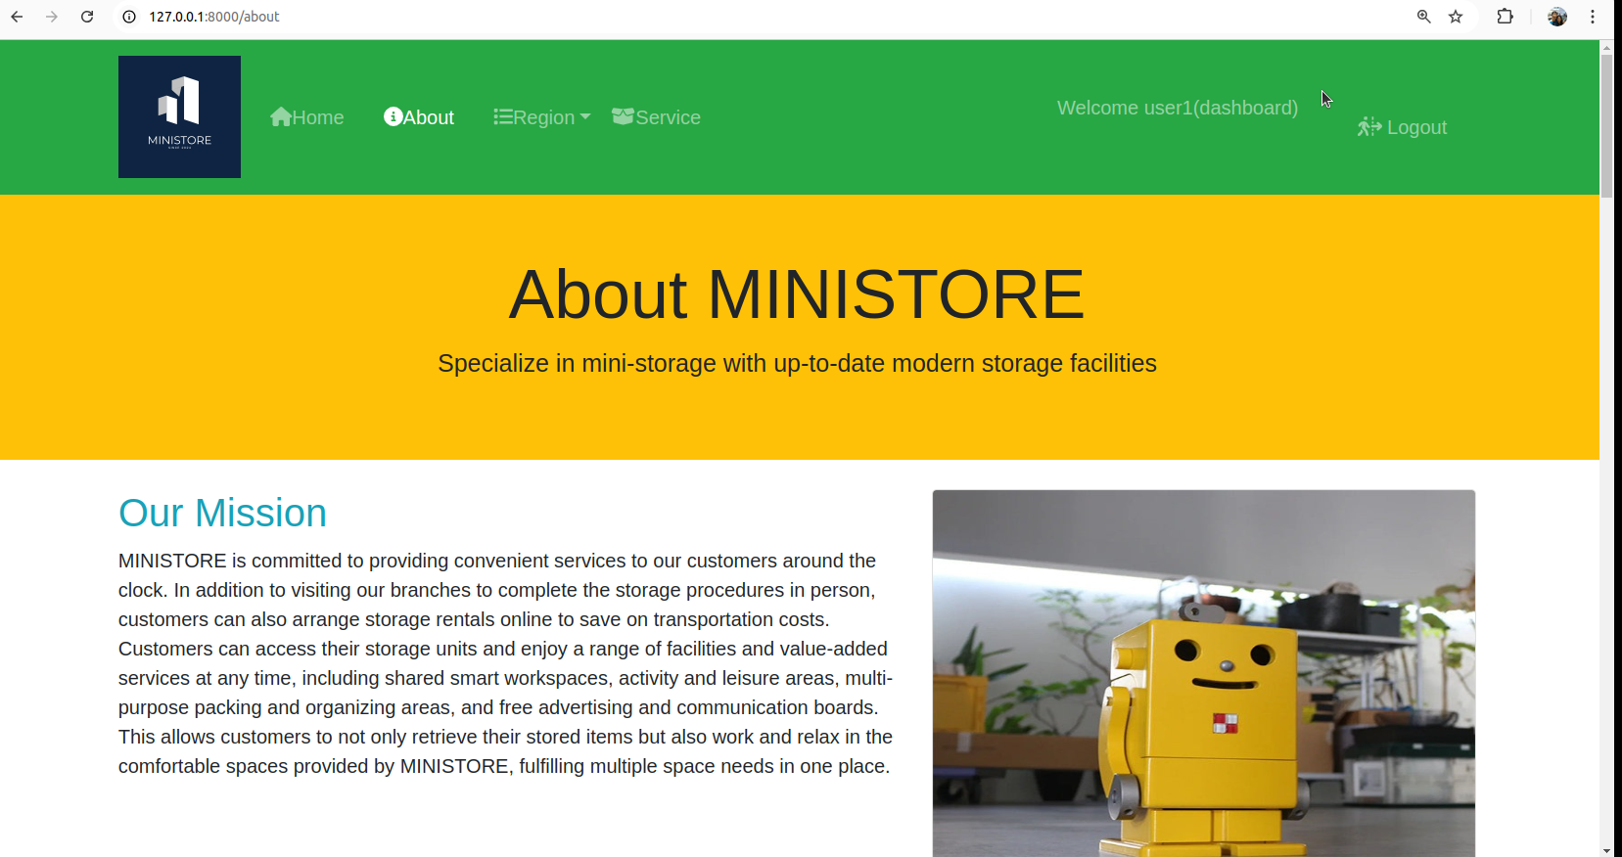
About Page

Slide 10
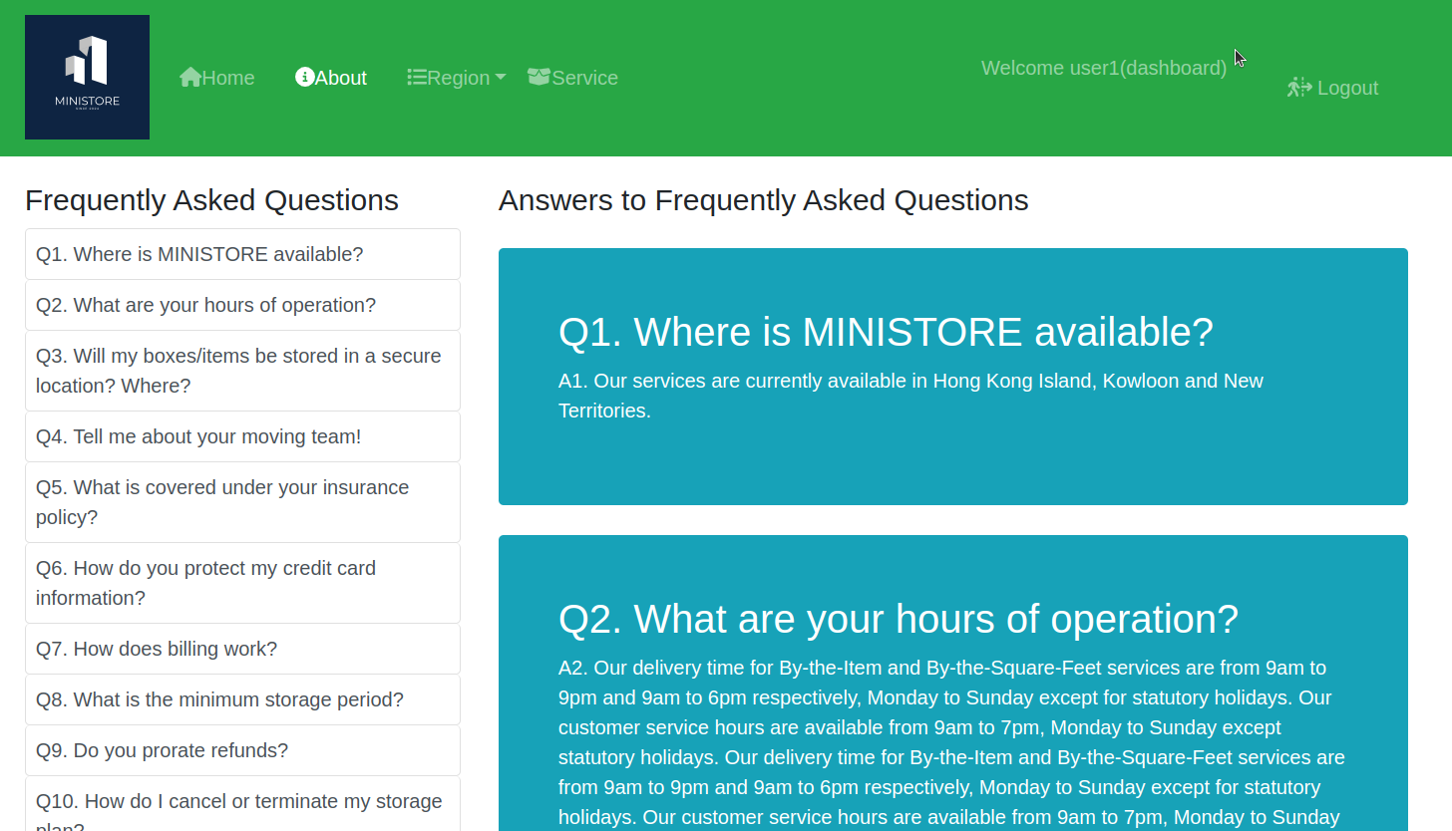
About Page
In the section of FAQ, “scrollspy” is used for illustration

Slide 11
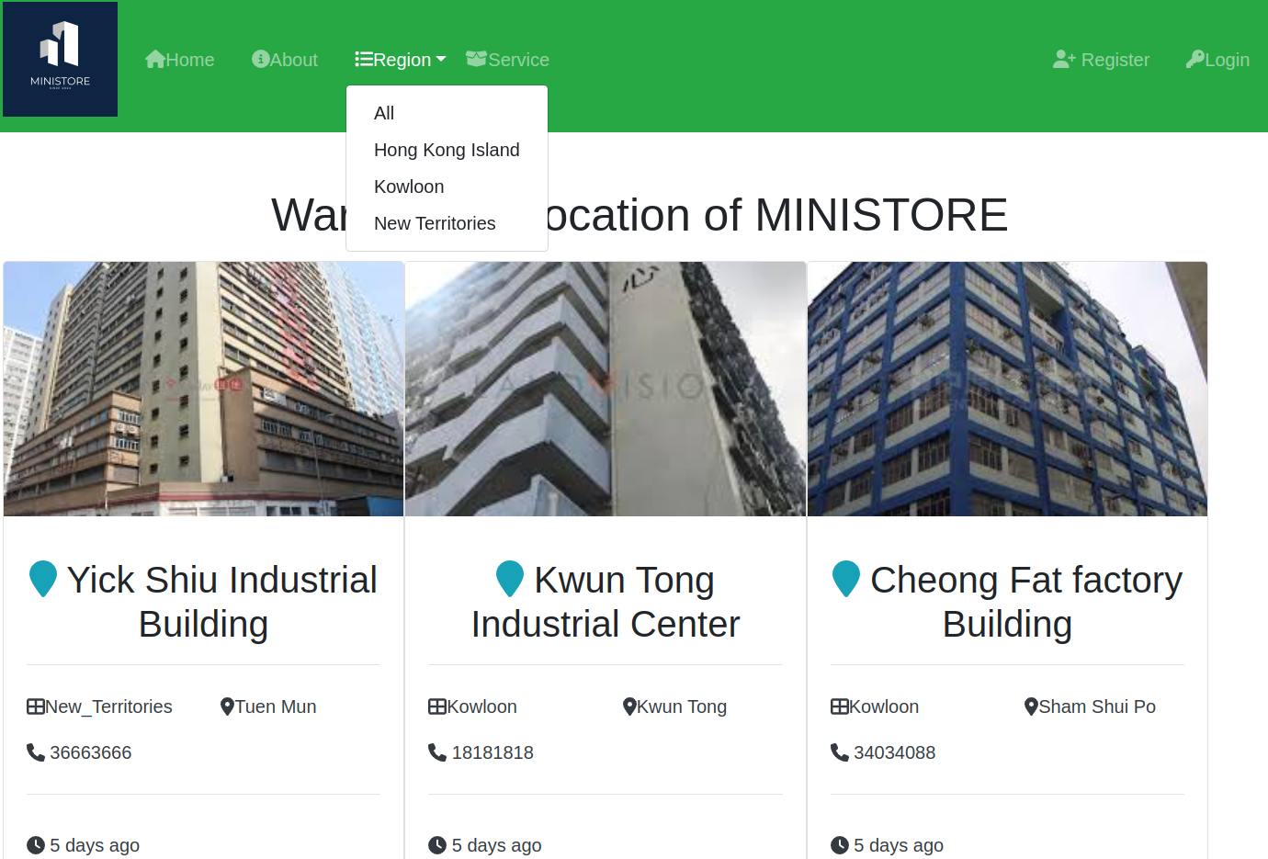
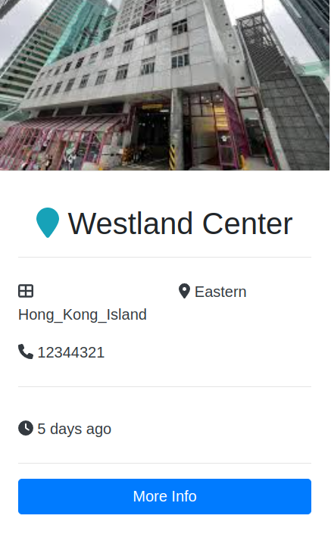
Region Page
Various information of warehouse can be loaded from database of warehouse app
Click “More Address Info” or “More Info” can go to individual warehouse

Slide 12
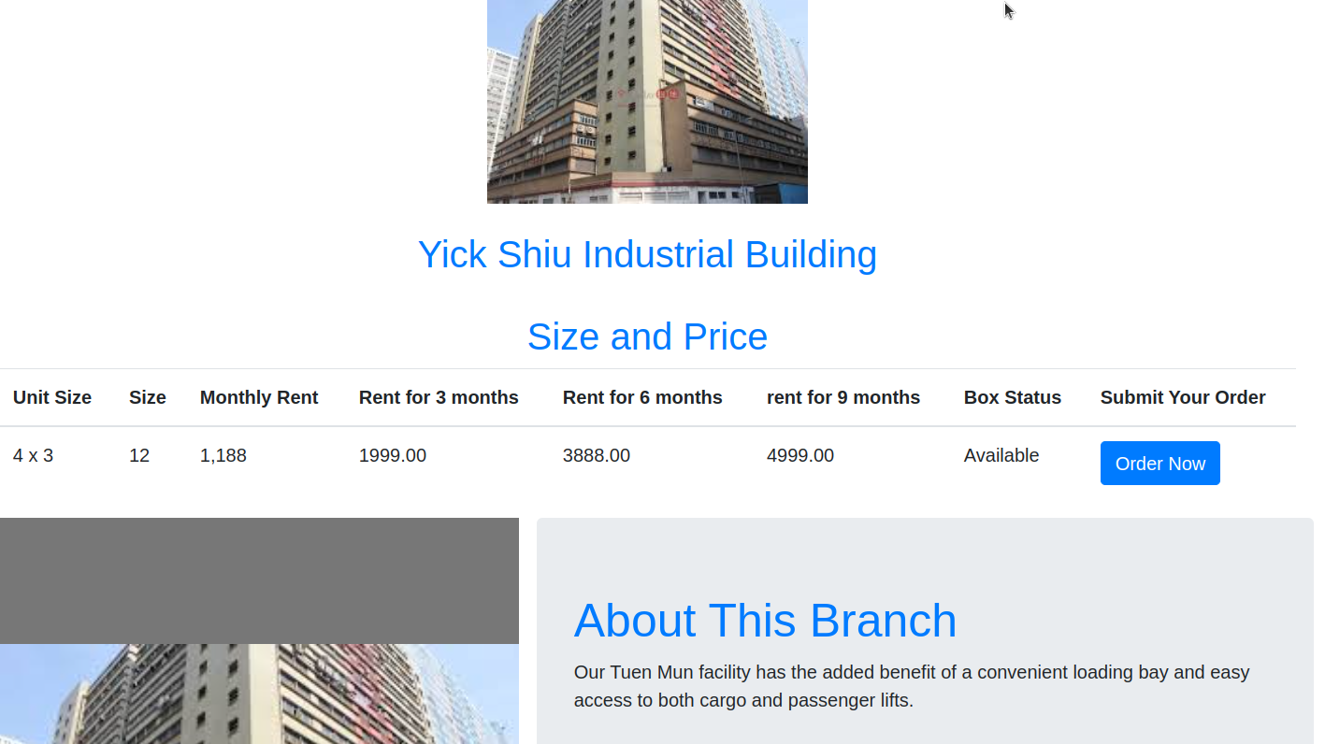
Individual Warehouse
- User can place order by clicking ‘Order Now’ button

Slide 13
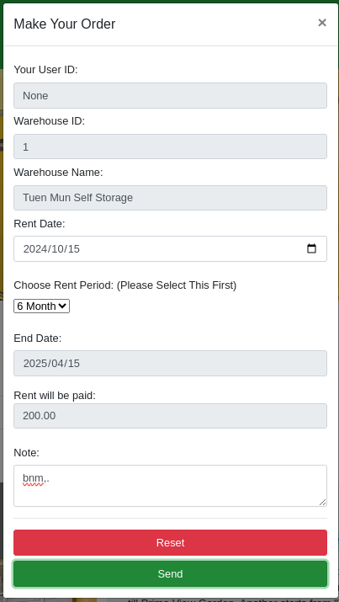
Individual Warehouse
Click ‘Order now’ button, order form will pop up for user to fill in information
In the table, rent for 3 months, 6 months, 9 months being loaded from database of warehouse

Slide 14
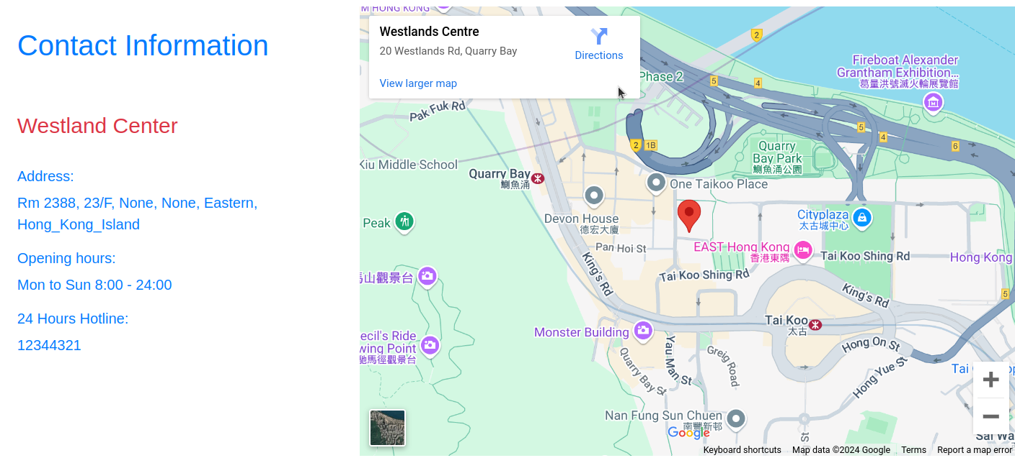
Individual Warehouse
Google map shows location of warehouse

Slide 15
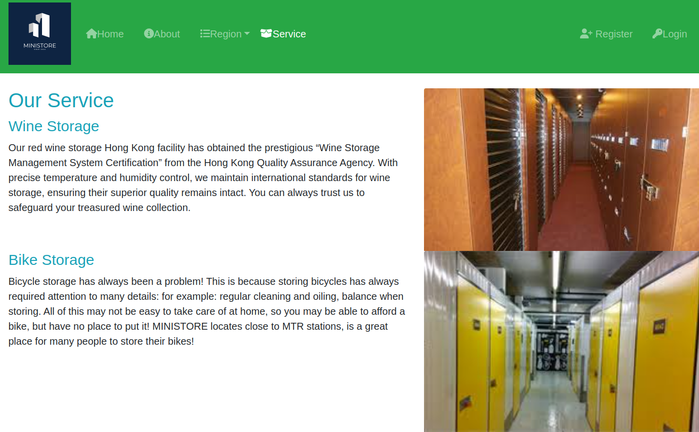
Service Page
Page just illustrate various different services

Slide 16
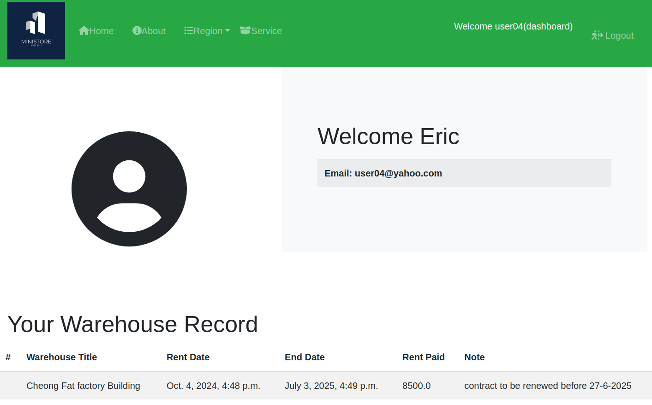
Dashboard
Welcome message
Email details and order records of the user will load the database of Transfer and Auth. User

Slide 17
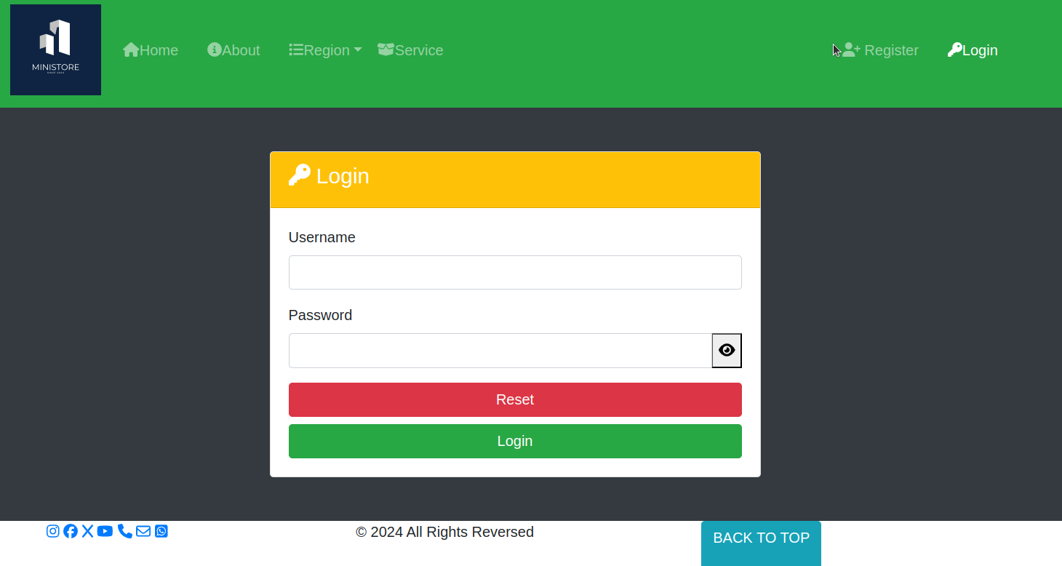
Register / Login
-
Build-in module of Django being used
Click Icon to view the input password

Slide 18
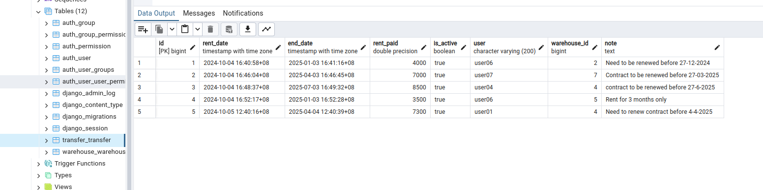
pgAdmin 4

Slide 19
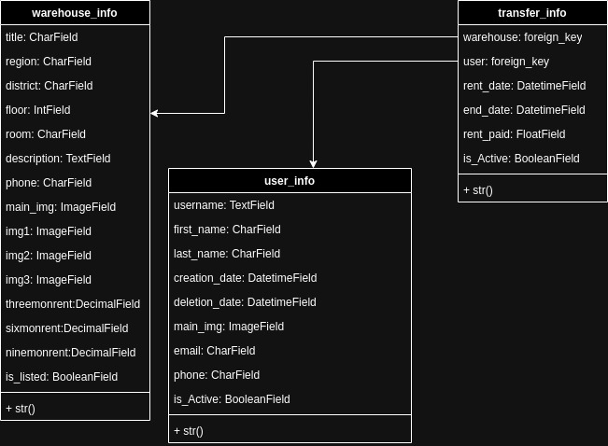
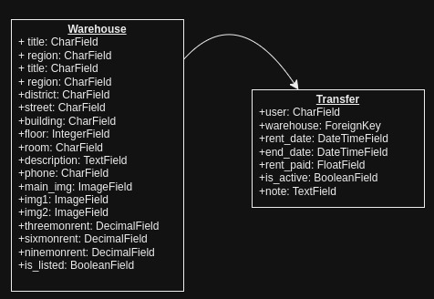
Chart to show relationship of Database
After
Before

Slide 20
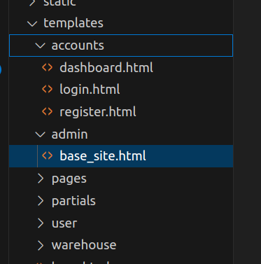
Templates/accounts/admin
Html files of dashboard, login and register under accounts
Html files of base_site under admin

Slide 21
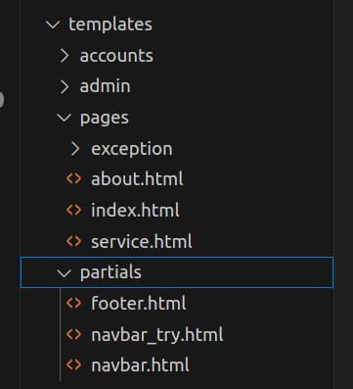
Templates/pages/partials
Html files of index, about and service under pages
Html files of navbar, footer under partials

Slide 22
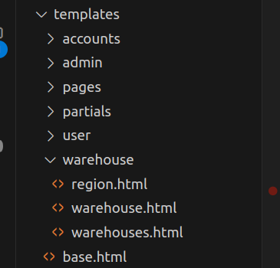
Templates/warehouse base.html
Html files of region, warehouses and warehouse under warehouse
Html file of base

Slide 23
Difficulties Encounter
Original created user_user database being conflict with Django auth.user database
Not familiar with Front End Design
Not fully understand the flow of Django, sometimes by try and error, it is time consumed
Programming problems e.g.
Problem to filter information of login user to put in Dashboard page
During form submission, meet problem of submitting order and generating message
- As team members are with different background, it is not easy to co-ordinate the work
within the team. Thanks to each member’s patience and input, finally we can complete
the project.

Slide 24
Future Development
Add database to hold different sizes of storage boxes
Can be more detailed when designing the database (eg can divide warehouse database into two parts, one for basic information, one for box choice)
Add PAYMENT or other possible features(eg promotion sales discount)
User Interface should be more attractive and add more interactions with user (eg dynamic effect popup windows, etc.)

Slide 25
Reflections of Team Member
Too many information to digest in two and half months
Do not have basic knowledge on web development and computer technology
After working on project, get more understanding on using Django for web development

